Slide 1
Bank Marketing Analysis
By Maithreyan K.

Slide 2
Dataset
The dataset is related with direct marketing campaigns of a Portuguese banking institution. The marketing campaigns were based on phone calls.
Output-Binary Classification has the client subscribed a term deposit
(binary: 'yes‘ , 'no‘)
20 Input variables
bank client data:7
related with the last contact of the current campaign:4
social and economic context attributes:5
other attributes:4

Slide 3
Imbalanced dataset
Ratio of two output classes are:
No-36548 Yes-4640
The dataset is imbalanced therefore accuracy would not be an appropriate evaluation metrics, so we prefer AUC score and F1 score to evaluate the model.

Slide 4
Data Preprocessing & Visulization
Data Visualization is used to understand the data set better.
Seaborn and Matplotlib is used visualize and analyze the dataset.
Understanding the data helps in filling the unknown values.

Slide 5
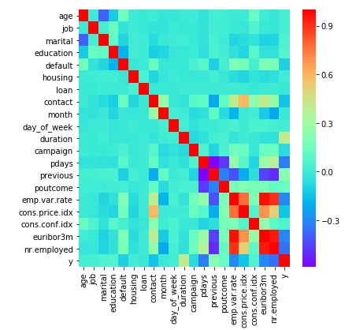
Co-relation Heat-map

Slide 6
Various ML models
Model | Training AUC Score | Validation AUC Score
Random forest | 0.918 | 0.763
Logistic Regression | 0.690 | 0.684
KNearestNeighbour | 0.712 | 0.684
Xgboost | 0.734 | 0.733

Slide 7
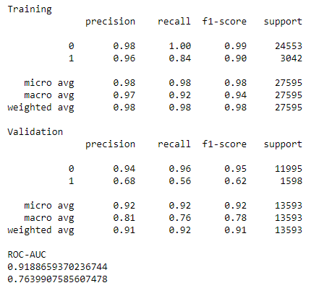
Best Model
Random Forest
n_estimators=70,min_samples_leaf=3, max_features=0.5

Slide 8
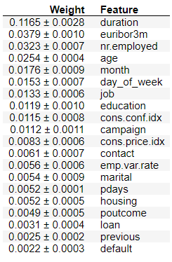
Important Feature

Slide 9
Market Suggestion
Features | Suggestions
Age | Concentrate on senior citizens
Duration of call | Try to have long conversation with customer, tell about the long term benefits.
Euribor3m, Nr.employed | These features play key role, so market team should concentrate in it.
Job | Target people who are in admin jobs.
Campaign | Give importance to customers who are campaigned more previously.
Education | Prioritize customers with University Degree.

Slide 10
Reducing Marketing Cost
Knowing the right customer to target, improves the conversation rate.
Understanding your target audience, reduces the overall marketing cost and improves prospects.
By knowing these insights the company can spend its valuable resources wisely and gain more profit.

